Slide 1
healthcare dataset
By MOHIT KUMAR

Slide 2
The dataset contains 55,500 rows and 15 columns: Here are the main columns that might be useful for analysis:
Age: Patient's age.
Gender: Gender of the patient.
Blood Type: Patient's blood type.
Medical Condition: Primary health issue.
Billing Amount: Medical billing amount.
Admission Type: Whether the admission was urgent, elective, or emergency.
Test Results: Medical test outcomes (e.g., Normal, Abnormal).

Slide 3
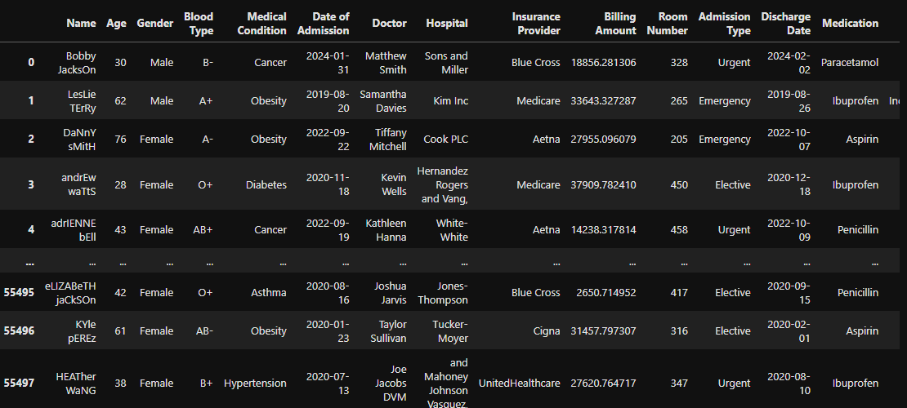

Slide 4
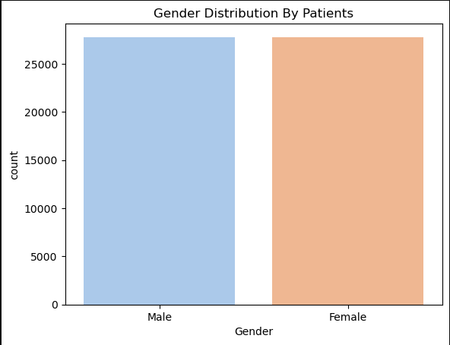

Slide 5
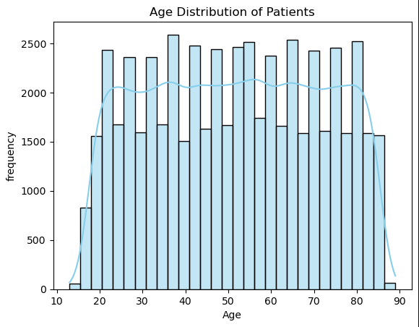

Slide 6
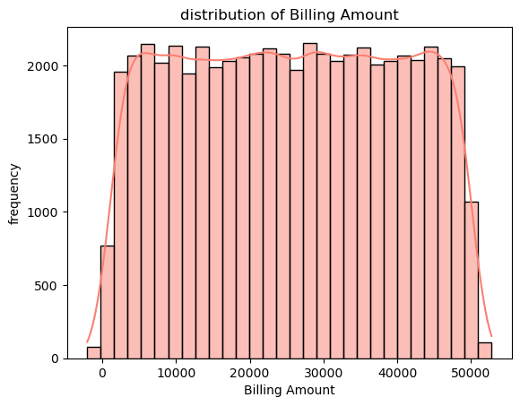

Slide 7
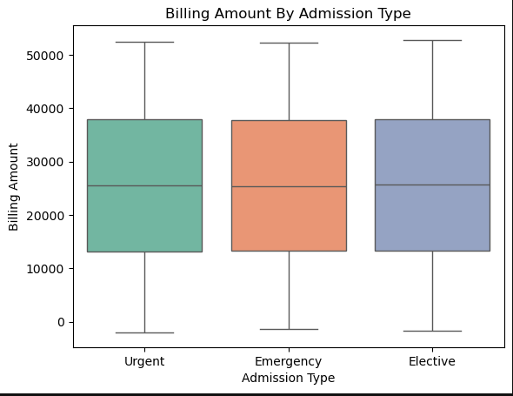

Slide 8
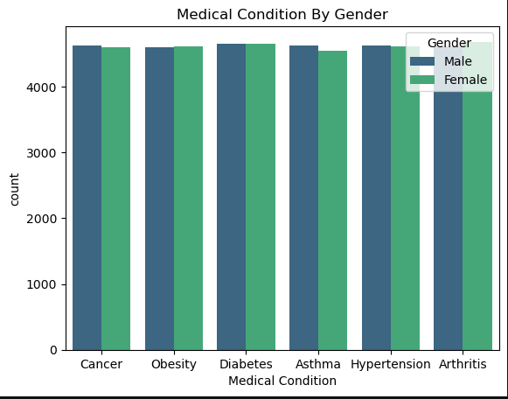

Slide 9
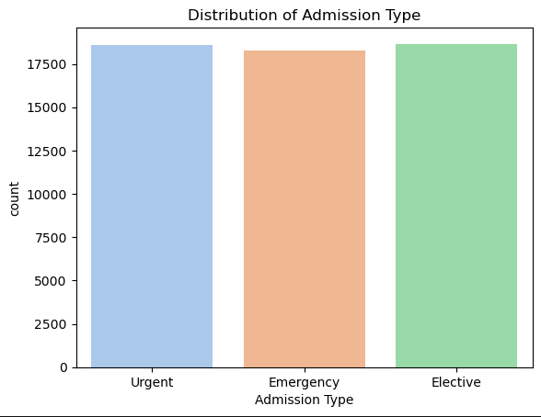

Slide 10
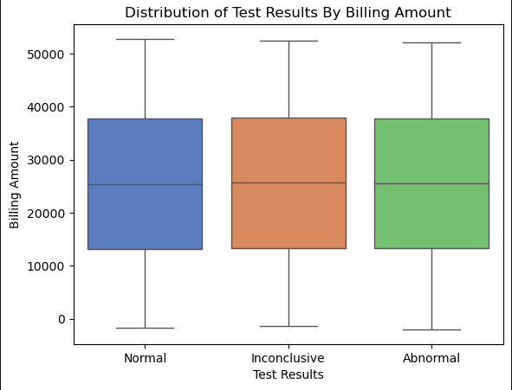

Slide 11
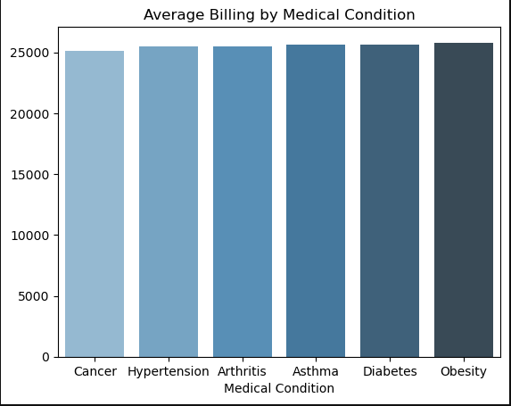

Slide 12
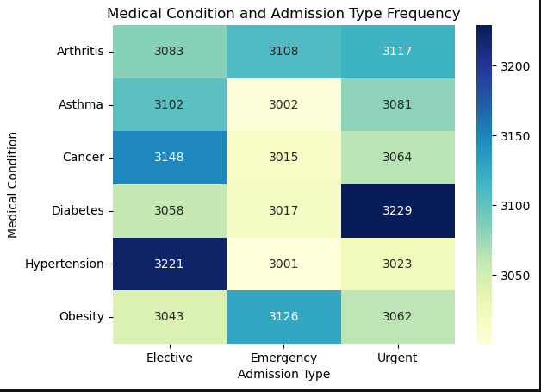

Slide 13
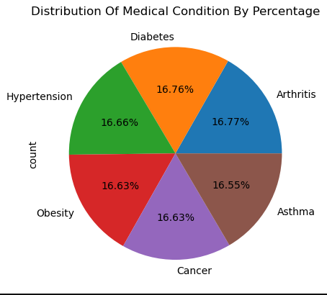

Slide 14
Conclusion
Supports Strategic Budgeting: Identifies cost drivers by age and medical condition.
Guides Resource Allocation: Highlights demand for emergency vs. elective care.
Enables Targeted Planning: Insights help in planning age-specific and condition-specific healthcare strategies.

Slide 15
THANK YOU

